Slide 1

CSG1105 / CSG5130
Applied Communications
Chapter 10
Switching and Routing

Slide 2
Objectives
Explain the basic differences between hubs and switches
Discuss the difference between store-and-forward switching and cut-through switching
Understand the function of the Spanning Tree Protocol
Describe the differences between a switch and a router
Explain the differences between distance-vector and link-state routing protocols and give examples of each

Slide 3
Objectives (cont’d.)
List several Autonomous Systems and their regions
Illustrate the differences between interior and exterior routing protocols
Describe how Classless Domain Internet Routing increased the availability of Internet addresses
Compare and contrast Distance Vector, Link State, and Policy Routing algorithms

Slide 4
Hubs versus Switches
Hubs broadcast received frames to all other ports
Switches forward received frames to a specific port
Fully switched network
  LAN stations connect to switched port
  Partitions network into separate collision domains
    Stations have unrestricted access to dedicated bandwidth, operate at switched port speed
    Maximum Ethernet network size: 1024 nodes
Switches learn associated port MAC addresses

Slide 5
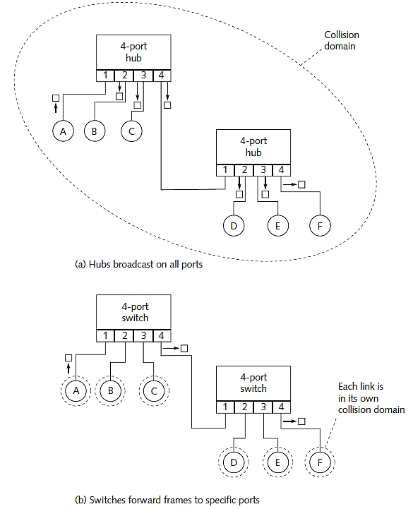
Figure 10-1 Comparing a hub and a switch

Slide 6
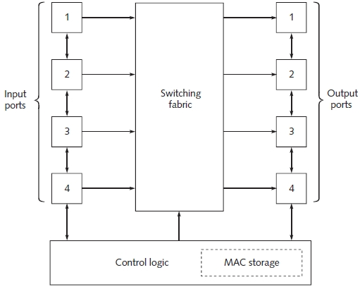
Inside a Switch
Switch components
Figure 10-3 Block diagram of a switch

Slide 7
Inside a Switch (cont’d.)
Switch components (cont’d.)
  Input port logic contains:
    Ethernet receiving logic
    Buffer for received frames
  Output port logic contains:
    Ethernet transmitter
    Output frame buffer
  Switching fabric
    Directs input port frames to the output port
    Handles broadcasts to all output ports

Slide 8
Inside a Switch
Switch components (cont’d.)
  Switching fabric (cont’d.)
    Crossbar switch: two-dimensional set of data buses
    Multiplexed bus: makes one input-output connection at a time
  Control logic chores
    Updating, searching MAC address table
    Configuring switching fabric
    Maintaining proper flow control through switch fabric
  Content addressable memory (CAM)
    Stores MAC addresses, port numbers

Slide 9
Store-and-Forward Switching
Entire frame stored when received
  No immediate routing decisions made
  Latency
    Delay between frame receive time and transmission start time
    Dependent on frame length
    Minimum latency obtained with minimum size frame
    Applications may be sensitive to latency (streaming audio, video)

Slide 10
Cut-Through Switching
Forwarding process begins immediately
  When incoming frame destination MAC address received
Advantages of cut-through switching
  10-Mbps Ethernet latency reduced to 11.2 microseconds
    Plus any additional time for internal switch operations
  Fixed latency
Disadvantages of cut-through switching
  Error propagation

Slide 11
Spanning Trees
Compatible switch uses a Spanning Tree Algorithm
  Spanning Tree Protocol (STP)
    Prevents looping
    Prevents network flooding from duplicate data frames
Dynamic filtering
  Redundant links causing loops held in reserve
Rapid Spanning Tree Algorithm and Protocol (RSTP)
  Replaced Spanning Tree Protocol
  Multiple Spanning Tree Protocol (MSTP)
    Supports multiple trees in the network

Slide 12
Switches versus Routers
Switches: layer 2 (Data-Link) devices
  Use MAC addresses to forward frames
  Used within networks to forward local traffic
Routers: layer 3 hardware device
  More complex than a switch
    Microprocessor-based circuitry
  Higher latency than a switch
    Additional packet processing required
  Routers used between networks
Nonroutable protocols pass through switches
  Not routers

Slide 13
Routing Protocols
Perform different type of packet forwarding
Operate at Network layer (Layer 3)
  Logical network formed by routers
    Example: the Internet
Router
  Moves data between source, destination computers
    Can be different network types
  Follows general ground rules
Windows NETSTAT program
  Shows currently active routes

Slide 14
Routing Protocols (cont’d.)
Routing table creation and maintenance methods
  Static routing
    A number of predefined routes created
    Router lacks ability to discover new routes
    Network administrator involvement required
    Not fault tolerant
  Dynamic routing
    New routes discovered; old routes updated as required
    Routing tables maintained automatically
    Fault tolerant
    Uses distance-vector or link-state routing algorithm

Slide 15
Autonomous Systems
Individual networks
  Grouped together by region
  Controlled by single administrative authority
Autonomous System (AS) number
  Associated with each autonomous system
Have single, clearly defined external routing policy
Interior Gateway Protocol (IGP)
  Used inside of Autonomous Systems
Exterior Gateway Protocols (EGP)
  Exchange information between different systems

Slide 16
Interior Gateway Protocols
Communication inside Autonomous Systems
  Many protocols used as IGPs for IP networks
    Gateway-to-Gateway Protocol (GGP)
    Routing Information Protocol (RIP)
    Routing Information Protocol 2 (RIP-2)
    Interior Gateway Routing Protocol (IGRP)
    Extended Interior Gateway Routing Protocol (EIGRP)
    Open Shortest Path First (OSPF)
    Intermediate System to Intermediate System (IS-IS)

Slide 17
Exterior Gateway Protocols
Used between different Autonomous Systems (AS)
  Define how networks within an AS advertise outside the AS
    AS advertises “reachability” to connectable networks
  Use Exterior Gateway Protocols (EGP) messages
    Independent of IGPs used within Autonomous Systems
    Facilitate exchange of routes between Autonomous Systems using different IGPs
  Protocols used for EGPs in IP networks
    Exterior Gateway Protocol (EGP)
    Border Gateway Protocol (BGP)
    Open Shortest Path First (OSPF)

Slide 18
Classless Inter-Domain Routing
Developed to recover unused class A and class B network addresses
Supported by interior and exterior gateway protocols
Based on route aggregation
Known as supernetting
Eliminates class concept
  IP addresses and their subnet masks:
    Written as four octets, separated by periods
    Followed by a forward slash, two-digit number that represents subnet mask length

Slide 19
Classless Inter-Domain Routing (cont’d.)
Class B network 178.217.0.0
  Class C supernet address in CIDR notation
    178.217.0.0/24
    /24 indicates a 24 bit subnet mask
Route aggregation
  Using several different routes so that a single route can be advertised
    Minimizes routing table size

Slide 20
Distance-Vector Routing
Also called Bellman-Ford algorithm
Based on number of hops in a route
  Between source and destination computers
Distance-vector routing algorithm
  Each router sends entire routing table (to its neighbor) every 30 seconds
  Distributed between network routers
Metric based on number of hops to take to reach destination
  Number of hops from any router to itself: 0
  Connection to a neighbor: 1

Slide 21
Distance-Vector Routing (cont’d.)
RIP uses UDP transport protocol
  Router hops specified in 4-bit field (15 hop maximum)
    Field value of 16 (all 1s) represents infinity
  Disadvantages
    Bandwidth usage can become excessive
    Difficult to debug, no security
  Benefits
    Runs on every router platform
    Little effort to configure the RIP protocol
    No computation, storage requirements
  RIP-2 provides additional features

Slide 22
Distance-Vector Routing (cont’d.)
Inter-Gateway Routing Protocol
  Cisco-proprietary solution to RIP issues
  Regarded as an Interior Gateway Protocol (IGP)
    Used as EGP for inter-domain routing
  Hold down feature prevents premature use of unstable route
  Poison-reverse update to eliminates routing loops
  Split horizon prevent information from being sent back on a source direction link
  Offers several new timer variables

Slide 23
Distance-Vector Routing (cont’d.)
Enhanced Inter-Gateway Routing Protocol
  Cisco-proprietary solution
  Improves IGRP operating efficiency by using:
    Distributed update algorithm
    MD5 authentication
    Protocol Independent Routing
    Metric changes (not entire routing tables) exchanged every 90 seconds
    CIDR support

Slide 24
Link-State Routing
Broadcasts cost of reaching each neighbor
  To all network routers
  Creates consistent network view at routers
Method to compute shortest distance
  Based on Dijkstra’s algorithm
    Open shortest path algorithm
Difference between distance-vector and link-state routing
  Path with least hops may not be chosen as the least-cost route

Slide 25
Link-State Routing (cont’d.)
Many routing protocols based on link-state algorithm
  End System to Intermediate System
  Intermediate System to Intermediate System
  NetWare Link Services Protocol
  Inter-Domain Routing Protocol
  Exterior Gateway Protocol
  Border Gateway Protocol

Slide 26
Policy Routing
Routing based on factors other than “shortest path”
Primary use
  Accommodates interconnected networks acceptable use policies
Other considerations
  Contract obligations
  Quality of service (resource reservation)
  Service provider selection
  BGP supports policy-based routing
  Complex set up and management
  Great rewards

Slide 27
Multi-Protocol Label Switching
Allows faster, cheaper IP routers
  Based on ATM technology
Labels: shorter than IP addresses
  Packets forwarded faster
  IP address independent allowing for policies
Layer 2 network link information integrated into Layer 3 (IP)
  Occurs within a particular Autonomous System
    Simplifies, improves IP datagram exchange
Great flexibility to divert and route traffic

Slide 28
Private Network-Network Interface
ATM forum specification
  For protocols between switches in private ATM network
Two main features:
  Routing protocol
    Reliably distributes network topology information
    Paths to any addressed destination computed
  Signaling protocol
    Establishment and takedown of point-to-point and point-to-multipoint connections

Slide 29
Layer 3 Switching
Switch and router combined into one package
Reason for popularity
  Ever-increasing demand for bandwidth and services
Utilizes ASIC (application specific integrated circuit) technology
  Implements routing functions in hardware
  Switch performs router duties
    Forwarding frames significantly faster
Layer 3 switch has many benefits

Slide 30
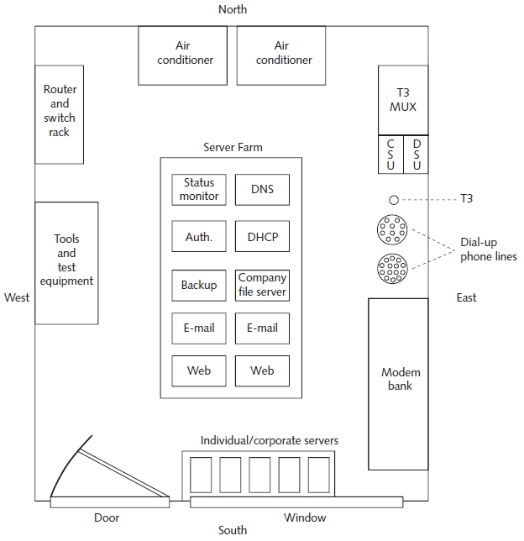
Inside an ISP
Figure 10-19 Overhead view of ISP network hardware

Slide 31
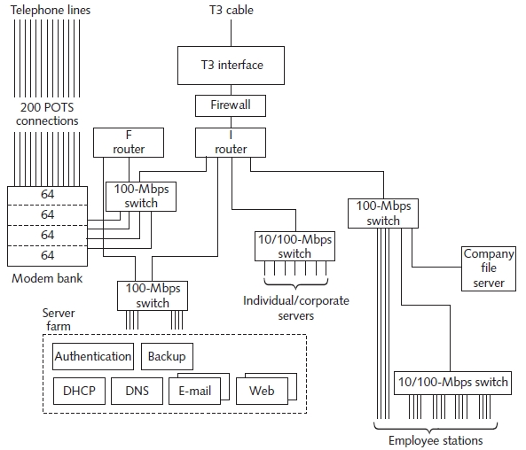
Inside an ISP (cont’d.)
Figure 10-20 ISP network diagram

Slide 32
Troubleshooting Techniques
Look at the big picture
Use http://www.internettrafficreport.com
  Check router status across the Internet
  Check traffic characteristics
Use http://www.internetpulse.net
  Provides latency, network utilization, packet loss information
    For major Internet backbone Tier One providers
Use http://www.caida.org
  Underlying Internet network topology information

Slide 33
Summary
Hubs, switches, and routers operate differently
  Switches operate at layer 2
  Routers operate at layer 3
Routers connect different types of networks together
  Static, dynamic routers
Switching techniques
  Store-and forward, cut-through
Autonomous networks grouped by region
Classless Inter-Domain Routing frees addresses
Many protocols support switching and routing

